Slide 1


PREDICTIVE MODELLING ON
ACTIVITY RECOGNITION FOR
WEARABLE DEVICES
Big Data Analysis | Group #13
Anjali Shahi
Chaitanya Kunapareddi
Akash Kandarkar

Slide 2
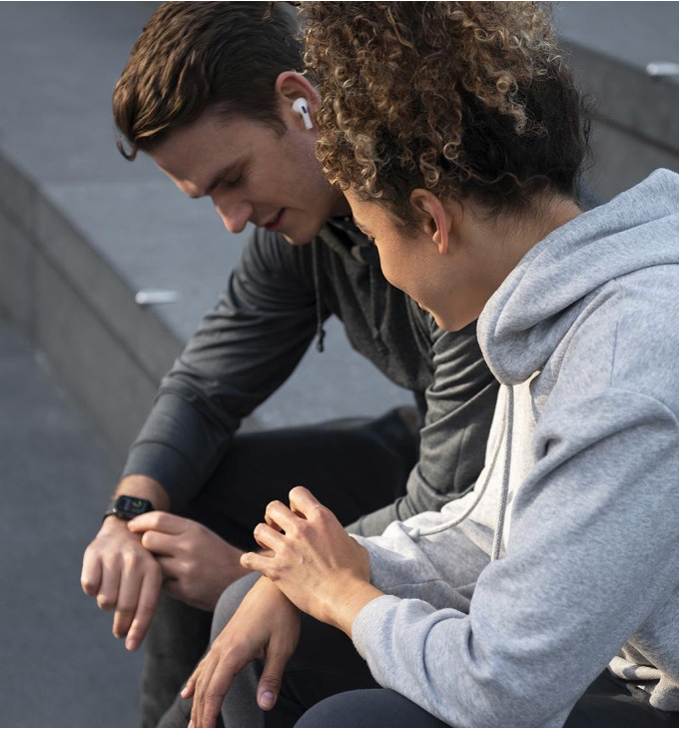
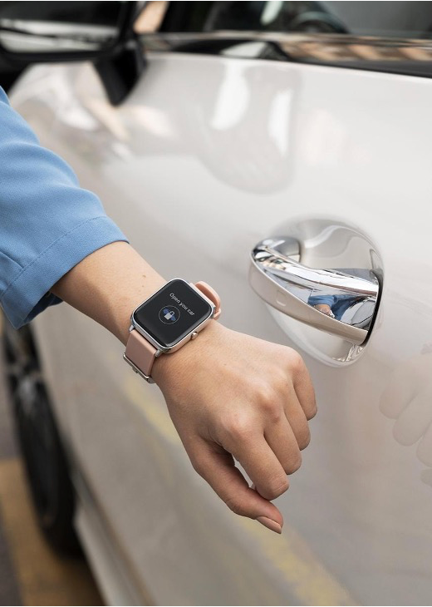
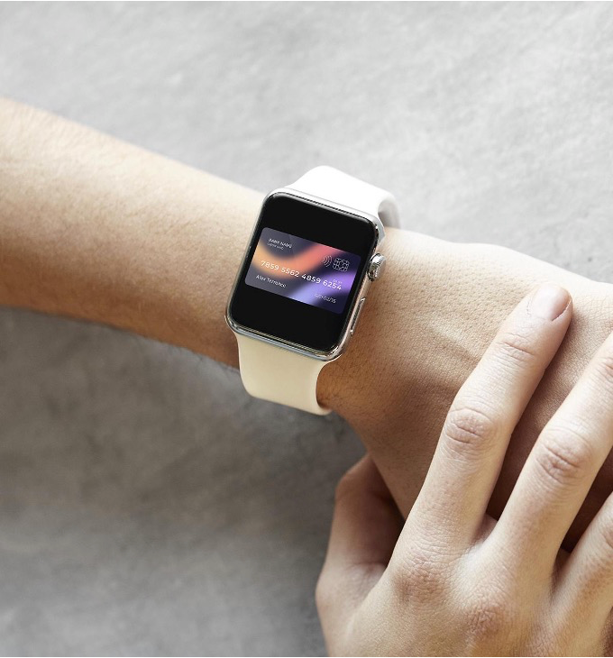
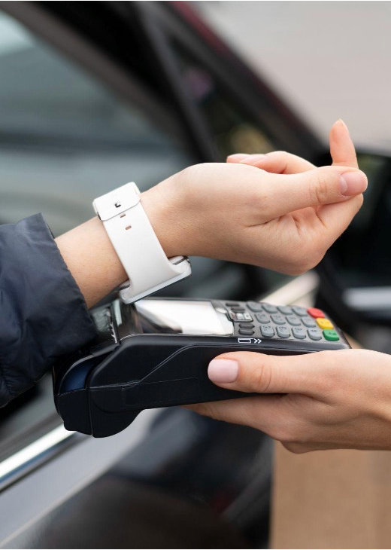
PROJECT OVERVIEW
Exploring machine learning and statistical components for data analysis
Analyzing user lifestyle using smart watch data
Prediction of undefined activities
Enhancing activity prediction

Slide 3
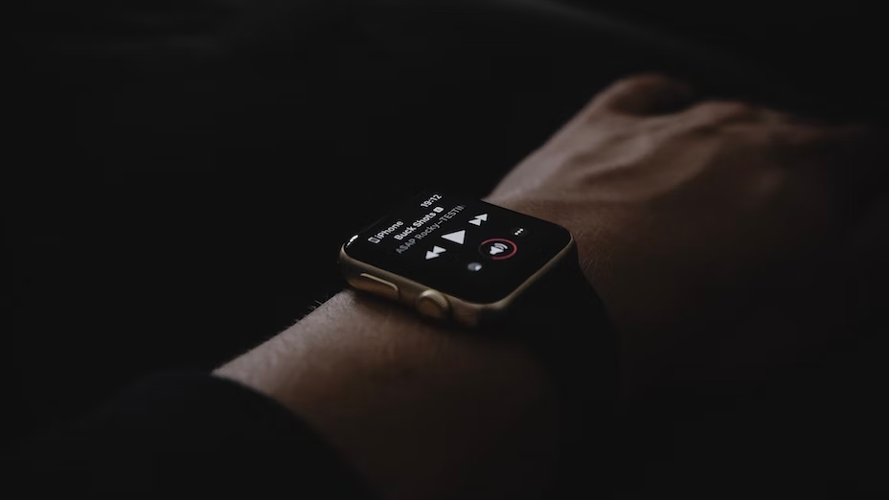

PROJECT OVERVIEW
TARGET
Identifying a relationship and calculating the proportion of static to motion activities
PREDICTION
Examine how explanatory variables and data affect model accuracy
Enhance the accuracy of smart watch activity prediction
INFERENCE
Attributes contribution towards activity tracking
GOALS
Physical health fitness tracking
Recognizing activities dependent on the time of day

Slide 4

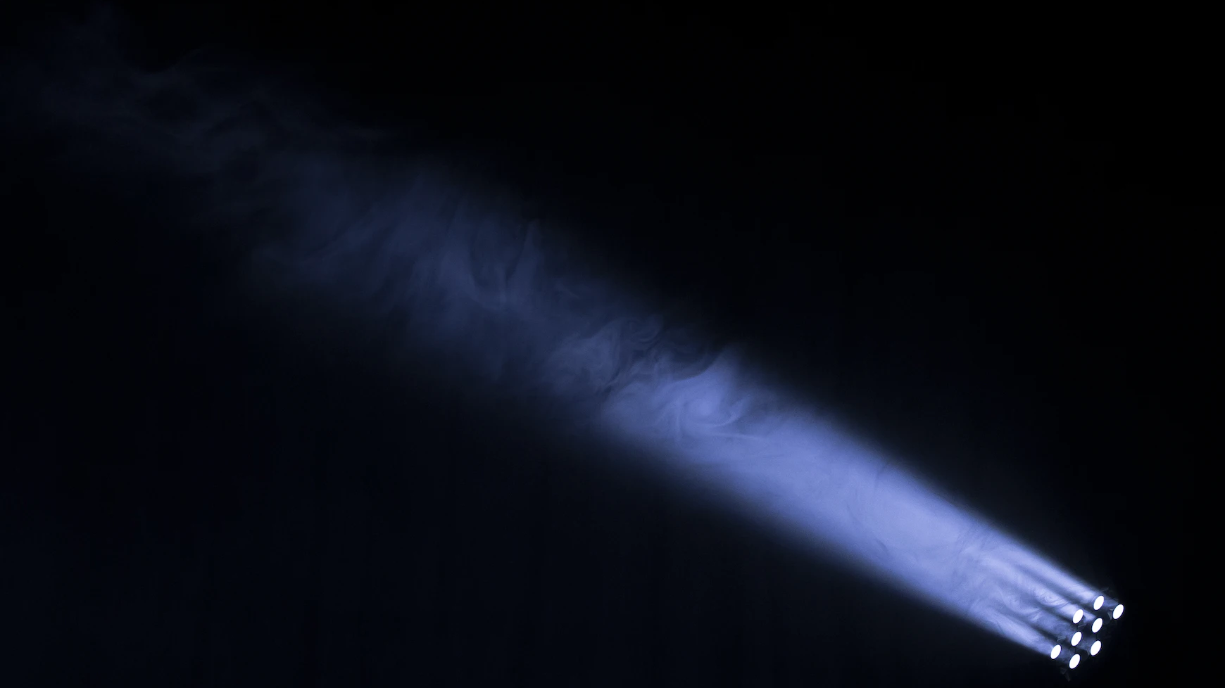
ACTIVITY TYPE DISTRIBUTION
Stairs Down
13.6%
Bike
17.2%
Stairs Up
13.7%
Walk
15.3%
Stand
13.1%
Null
14.7%
Sit
12.5%

Slide 5
ACTIVITY TYPE DISTRIBUTION BY USERS
Stairs-Up
Bike
Walk
Stairs-Down
Stand
Sit
null
25,000
20,000
15,000
10,000
5,000
0
H
A
C
B
D
F
E
G
I

Slide 6
USERS BY ACTIVITY CATEGORY
Motion
Static
75,000
50,000
25,000
0
E
F
B
C
A
D
H
G
I

Slide 7
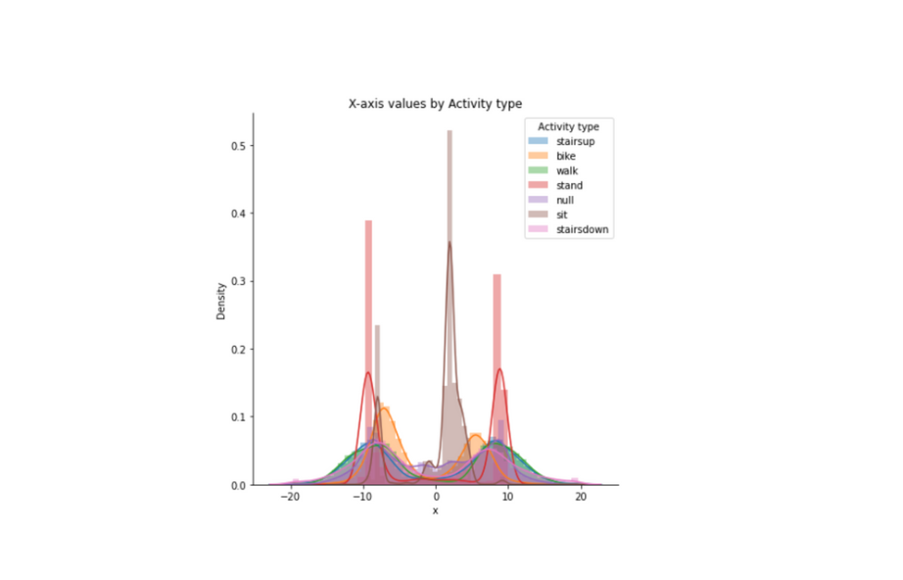
HORIZONTAL
PLANE
ACTIVITY
DISTRIBUTION

Slide 8
Methods Implemented
Modelling
Feature Selection
Standardisation
String indexing
Sampling
Random forrest
Logistic regressions
Decision Tree
Not all features add value
Sensors, time, device type are removed
3D-Plane data
Jerk-mean are scaled for uniformity
String indexing
Binned activities
Models
Time of day
Model type
Time of the day

Slide 9

Case 1 : Activity prediction
Captured attributes :
Tilt, plane and direction of watch
Device type and associated sensor
Device jerk metric
Target : Activity performed
Model Confidence
Model Confidence
Accurate - 40.1%
Error - 43.8%
Helps monitor day to day activities
Logistic Regression
Random Forest
Accurate - 56.2%
Model generated using best parameteres
Error - 59.9%

Slide 10
Case 2 : USER BASED ACTIVITY
Model Confidence
Captured attributes : Tilt, plane and direction of watch ; Device type and associated sensor; Device jerk metric.
Target : Activity performed
Filter - Activities performed by user 'F' in the afternoon.
Error
40.88%
Random Forrest
59.12%
Prediction Confidence
Accurate
correct
incorrect
750
Motion Vs Static
500
Static
250
Motion
0
stairsup
sit
stand
walk
bike
stairsdown
null

Slide 11
CASE 3 : DEVICE COMPARISION
SAMSUNG
Captured attributes : Tilt, plane and direction of watch ; Device type and associated sensor; Device jerk metric.
Target : Activity performed
Filter - Device - Samsung Vs LG
ERROR
41.6%
Accuracy
ACCURATE
58.5%
LG
stairsup
2.5%
Null
17%
Null
25.7%
stairsup
26.8%
sit
19%
staitsdown
3.3%
Activities
ERROR
43.3%
Activities
Accuracy
stairsdown
0.1%
stand
15.4%
ACCURATE
56.7%
bike
25.5%
bike
19.7%
sit
17.9%
walk
17.2%
walk
2.5%
stand
7.2%

Slide 12


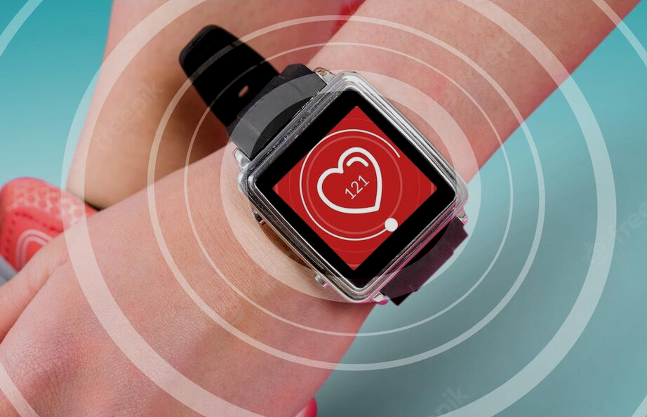



ROADBLOCKS
Limited number of features and Magnetometer Data could have helped obtain better accuracy.
The results generated by the sensors are highly sensitive to motion, hence contain noisy data as well.
Activities with similar motion types lead incorrect detection.
Limited computational capabilities in Google collab when working with hypertuning parameters.

Slide 13
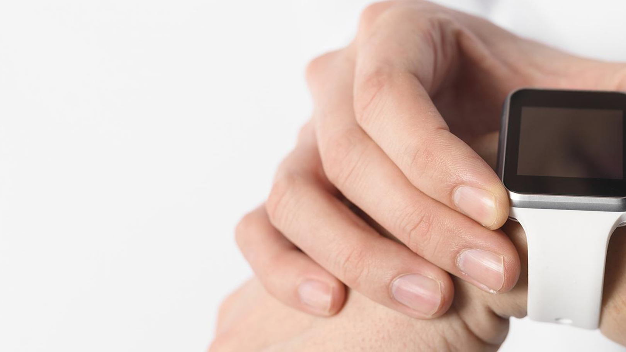
Summary
OVERVIEW
Using big data analytics to monitor physical activities of users and promote better fitness.
ANALYSIS
User activity classification based on available features as well as analyzing specific user activity at different time periods in a day.
BUSINESS INSIGHTS
Fine tuning classification model accuracy to help business leaders to develop more accurate wearable devices.

Slide 14





ROLES OF TEAM MEMBERS
Anjali
Shahi
Chaitanya Kunapareddi
Akash
Kandarkar
Exploratory data analysis
Understanding relation between users and activities
Analyzing sensor based data
Model comparison and analysis
Analyzing user activities and Device performances
Data profiling
Problem definition and defining and use cases
Summarised technical results into business terms
Exploratory data analysis

Slide 15
THANK YOU!

